Slide 1
Software Freedom Day 2017
Hybrid App Development with IONIC FRAMEWORK
Anup Kumar Panwar
UIET Chandigarh

Slide 2
84%
of Australian mobile subscribers are using a smartphone.

Slide 3
42%
of major Australian carrier revenue is from data traffic.

Slide 4
67%
of people use a personal device at work, regardless of BYOD policy.

Slide 5
11%
of end-users access business applications from the corporate office 100% of the time.

Slide 6
89%
of users access systems whilst outside the corporate office.

Slide 7
Mitch Denny
mitch.denny@readify.net
http://blog.mitchdenny.com
@mitchdenny

Slide 8
100%
of the previous statistics are published by organisations with a vested interest :-)

Slide 9
You don’t need a research team to tell you the profound impact mobility and cloud is having on society.

Slide 10
62%
of companies in survey currently have, or are planning a BYOD policy.

Slide 11
Worldwide Smartphone OS Share

Slide 12
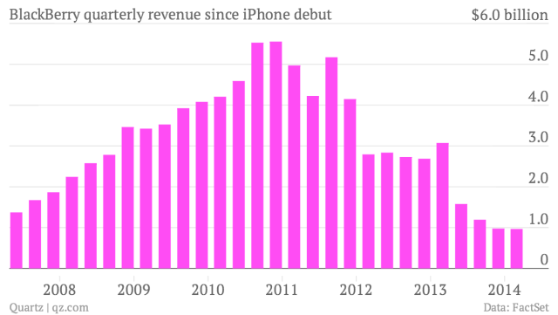

Slide 13


Slide 14
When users change handsets every two years its possible to get huge swings in OS popularity.

Slide 15
Adopting a BYOD policy requires a cross platform development strategy.

Slide 16
What are the key considerations in your X-platform development strategy?

Slide 17
So what are the options?

Slide 19
Mobile
Web

Slide 20
Mobile
Web
100%
Native

Slide 21
Hybrid
Web
Mobile
Web
100%
Native

Slide 22
Mobile
Web
Hybrid
Web
100%
Native

Slide 23
100% native
Community & Support
Unique Platform Features
Minimal Shared Logic
High Performance

Slide 24
Choosing an X-Platform Dev Strategy

Slide 25
Hybrid
Apps
Mobile
Web
100%
Native

Slide 26
Mobile Web
Common Frameworks
Responsive Design
HTML5
Media Queries

Slide 27
Issues
High Cost – approx. 3-4K
Less Revenue – Ad Blockers

Slide 28
When it comes to websites, all the smart kids are doing PROGRESSIVE WEB APPS

Slide 29
Mobile
Web
Hybrid
Apps
100%
Native

Slide 30
Hybrid Web
Apache Cordova
Ionic Framework
Visual Studio MDA

Slide 31
Apache Cordova
Mitch Denny

Slide 32
Setting-up Cordova via CLI
npm install –g cordova
cordova create helloworld com.example.hello “Hello World”

Slide 33
Adding Platforms
cordova platforms add ios
cordova platforms add android
cordova platforms add wp8

Slide 34
Searching Plugins
cordova plugin search [keyword]

Slide 35
Adding Plugins
cordova plugin add org.apache.cordova.battery-status

Slide 36
Listening to Events
function onBatteryStatus(data) {
// Do something with battery status.
}
window.addEventListener(
‘batterystatus’,
onBatteryStatus,
false
);

Slide 37
Build/Run
cordova run [platform]

Slide 38
Your Code
(HTML/JS)

Slide 39
Web View
Your Code
(HTML/JS)

Slide 40
Native Wrapper
Web View
Your Code
(HTML/JS)

Slide 41
Native Wrapper
Web View
Your Code
(HTML/JS)
Cordova
API

Slide 42
Native Wrapper
Web View
Your Code
(HTML/JS)
Cordova
API
Plugins

Slide 43
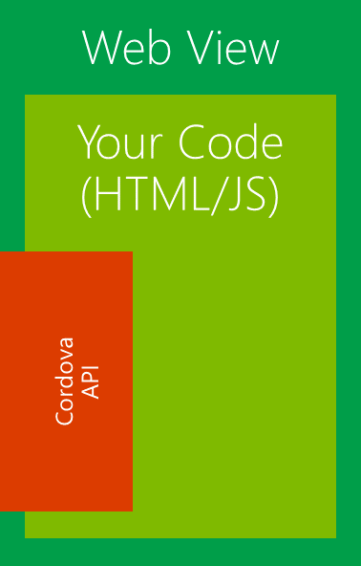
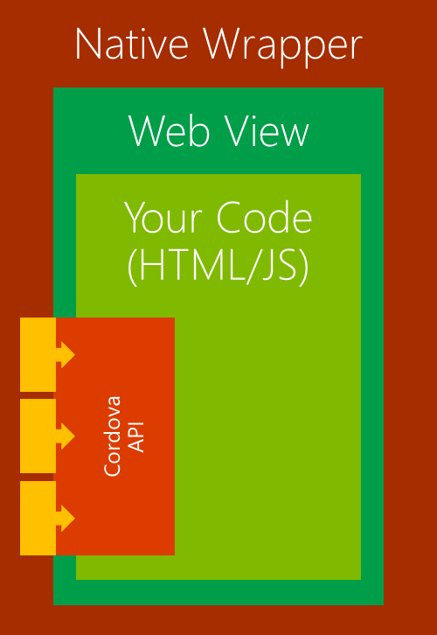
BUILD
PROCESS
config.xml

Slide 44
Ionic Framework
Mitch Denny

Slide 45
Setting-up Cordova with Ionic
npm install –g cordova ionic
ionic start helloworld sidemenu

Slide 46
What would I do?

Slide 47
It depends :-)

